Slide 1
CEG4750/6750 Information Security
Final Exam Review
Spring 2025
Notes:
Zili Shao

Slide 2
Final Exam Time and Location
All students will take the online exam.
  the exam will be available for checking out from 10:00 am – 11:30 pm April 28th, 2025
  You will have 120 minutes to work on the exam.

Slide 3
Policy
This is a close-book final exam
Students are allowed to carry a cheat sheet hand-written on a 4' by 6' note card (double sides)
Calculators with basic operation support (+/-/*/division) are permitted
You have totally 120 minutes.
You are not allowed to collaborate with other students during the exam
No aid given, received, or observed.
You will be given credits only for what appears in your submission.

Slide 4
Policy (Cont.)
Students should never share questions or answers of the exam paper with other students.

Slide 5
Topics covered by final exam
  Extended Euclid Algorithm – Computing the multiplicative Inverse
  RC4
  Advanced Encryption Standard
  Secure Hash Standard, and SHA-512
  SHA-3: Sponge Construction.
  HMAC, CMAC
  Key Management
  Diffie-Hellman Key Exchange & ElGamal Encryption & Decryption Algorithms
  Access Control: Authentication &Authorization

Slide 6
Extended Euclid Algorithm
Extended Euclid’s algorithm:
  EXTENDED EUCLID(m, b)
  (A1, A2, A3)=(1, 0, m);
  (B1, B2, B3)=(0, 1, b)
  2. if B3 = 0
  return A3 = gcd(m, b); no inverse
  3. if B3 = 1
  return B3 = gcd(m, b); B2 = b^{–1} mod m
  4. Q = A3 div B3
  5. (T1, T2, T3)=(A1 – Q B1, A2 – Q B2, A3 – Q B3)
  6. (A1, A2, A3)=(B1, B2, B3)
  7. (B1, B2, B3)=(T1, T2, T3)
  8. goto 2
CEG 260, Meilin Liu
Notes:
Zili Shao

Slide 7
Extended Euclid Algorithm
(1,0)
(0,1)
GCD(434, 37) = GCD (37, 27)
= GCD (27, 10) = GCD (10, 7)
= GCD (7, 3) = GCD (3, 1)
= GCD (1, 0) = 1
434 = 1 * 434 + 0 * 37
37 = 0 * 434 + 1 * 37
27 = 1 * 434 + (-11) *37
10 = (-1) * 434 + 12 * 37
7 = 3 * 434 + (-35) * 37
3 = (-4) * 434 + 47 * 37
1 = 11 * 434 + (-129) * 37
When we take modulo 434 on both sides of the equation, we get (-129)*37 mod 434 = 1
i.e., 305 * 37 mod 434 =1
So the multiplicative inverse of 37 mod 434 is 305.
434
*11
37
407
*1
27
(1,-11)
27
*2
10
(-1,12)
20
*1
7
(3,-35)
7
*2
3
(-4,47)
6
(11,-129)
1
CEG 260, Meilin Liu
Notes:
Zili Shao

Slide 8
RC4
A proprietary cipher owned by RSA DSI
Another Ron Rivest design, simple but effective
Variable key size, byte-oriented stream cipher
Widely used (web SSL/TLS, wireless WEP (Wired Equivalent Privacy) )
Key forms random permutation of all 8-bit values
Uses that permutation to scramble input info processed a byte at a time
CEG 260, Meilin Liu
Notes:
Zili Shao
RC4 is a stream cipher designed in 1987 by Ron Rivest for RSA Security. It is a variable key-size stream cipher with byte-oriented operations. The algorithm is based on the use of a random permutation. Analysis shows that the period of the cipher is overwhelmingly likely to be greater than 10^100. Eight to sixteen machine operations are required per output byte, and the cipher can be expected to run very quickly in software. RC4 is probably the most widely used stream cipher. It is used in the SSL/TLS secure web protocol, & in the WEP & WPA wireless LAN security protocols. RC4 was kept as a trade secret by RSA Security, but in September 1994 was anonymously posted on the Internet on the Cypherpunks anonymous remailers list. In brief, the RC4 key is used to form a random permutation of all 8-bit values, it then uses that permutation to scramble input info processed a byte at a time.

Slide 9
RC4 Key Schedule
Starts with an array S of numbers: 0..255
Use key to well and truly shuffle
S forms internal state of the cipher
  for i = 0 to 255 do
    S[i] = i
    T[i] = K[i mod keylen])
  j = 0
  for i = 0 to 255 do
    j = (j + S[i] + T[i]) (mod 256)
    swap (S[i], S[j])
CEG 260, Meilin Liu
Notes:
Zili Shao
The RC4 key schedule initialises the state S to the numbers 0..255, and then walks through each entry in turn, using its current value plus the next byte of key to pick another entry in the array, and swaps their values over. After doing this 256 times, the result is a well and truly shuffled array. The total number of possible states is 256! - a truly enormous number, much larger even than the 2048-bit (256*8) max key allowed can select.

Slide 10
RC4 Encryption
Encryption continues shuffling array values
Sum of shuffled pair selects "stream key" value from permutation
XOR S[t] with next byte of message to en/decrypt
  i = j = 0
  for each message byte M_{i}
    i = (i + 1) (mod 256)
    j = (j + S[i]) (mod 256)
    swap(S[i], S[j])
    t = (S[i] + S[j]) (mod 256)
    C_{i} = M_{i} XOR S[t]
CEG 260, Meilin Liu
Notes:
Zili Shao
To form the stream key for en/decryption (which are identical), RC4 continues to shuffle the permutation array S by continuing to swap each element in turn with some other entry, and using the sum of these two entry values to select another value from the permutation to use as the stream key, which is then XOR’d with the current message byte.

Slide 11
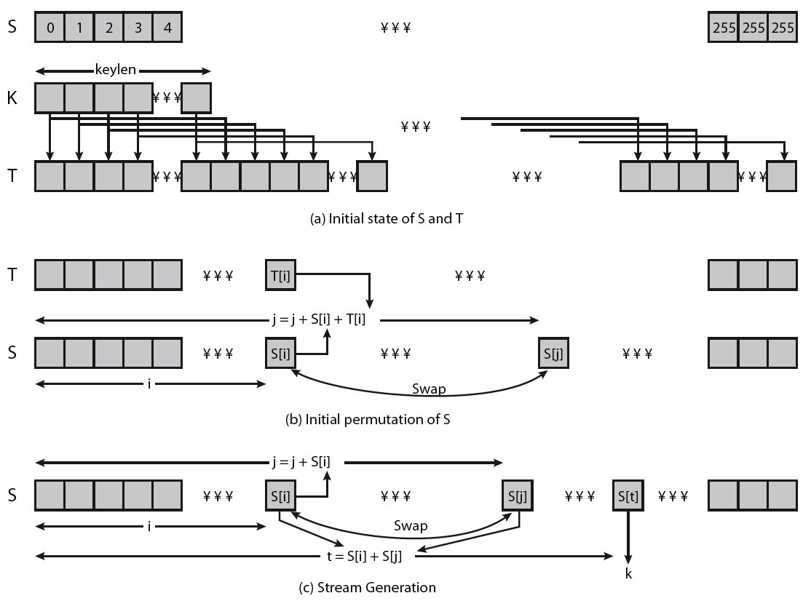
RC4 Overview
CEG 260, Meilin Liu
Notes:
Zili Shao
Stallings Figure 6.9 illustrates the general structure of RC4.

Slide 12
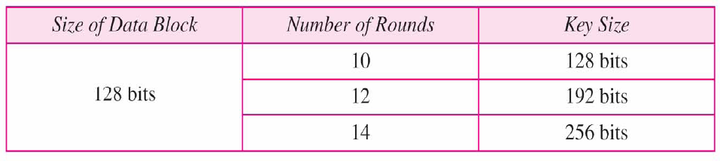
Advanced Encryption Standard
Also called Rijndael Algorithm
128 bit blocks, keys:-128, 192,256 bits long
NIST (National Institute of Standards and Technology) estimates that a machine that could crack 56-bit DES in one second (2^55 keys per second) would take approx. 149 trillion years to crack a 128-bit AES key.
CEG 260, Meilin Liu
Notes:
Zili Shao

Slide 13
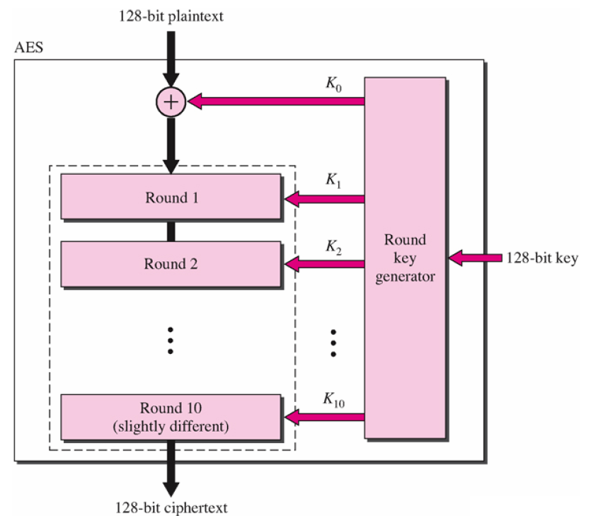
Advanced Encryption Standard
CEG 260, Meilin Liu
Notes:
Zili Shao

Slide 14
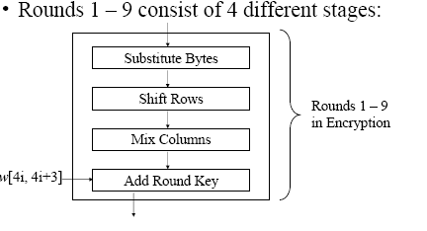
Advanced Encryption Standard
CEG 260, Meilin Liu
Notes:
Zili Shao

Slide 15
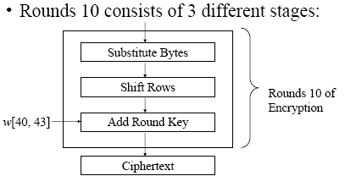
Advanced Encryption Standard
CEG 260, Meilin Liu
Notes:
Zili Shao

Slide 16
Advanced Encryption Standard
The 4 stages used in the rounds consist of three substitutions and one permutation
  Substitution Bytes (Substitution)
    S – Boxes in byte to byte substitution of block
  Shift Rows (Simple Permutation)
  Mix Columns (Substitution)
    Uses Finite field arithmetic on GF(2^8)
  Add Round Key (Substitution)
    Simple bitwise XOR of current block with portion of expanded key
    This is the only stage that uses the key
CEG 260, Meilin Liu
Notes:
Zili Shao

Slide 17
Advanced Encryption Standard
Decryption makes use of keys in reverse order – just as with DES
Decryption algorithm is not the same as the Encryption algorithm – unlike DES
The 4 stages used in the rounds consist of three substitutions and one permutation
  Inverse Shift Rows (Simple Permutation)
  Inverse Substitution Bytes (Substitution)
  Add Round Key (Substitution)
  Inverse Mix Columns (Substitution)
10th round involves 3 stages as in encryption
CEG 260, Meilin Liu
Notes:
Zili Shao

Slide 18
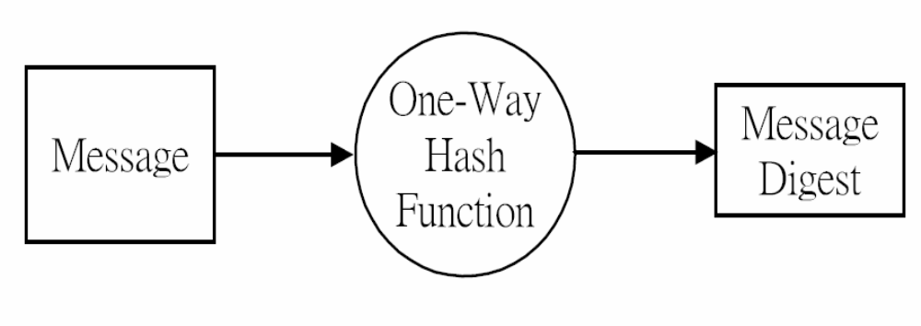
Hash and Message Digest
CEG 260, Meilin Liu
Notes:
Zili Shao

Slide 19
Requirements for Hash Functions
can be applied to any sized message M
produces fixed-length output h
is easy to compute h=H(M) for any message M
given h is infeasible to find x s.t. H(x)=h
  one-way property
given x is infeasible to find y s.t. H(y)=H(x)
  weak collision resistance
is infeasible to find any x,y s.t. H(y)=H(x)
  strong collision resistance
CEG 260, Meilin Liu
Notes:
Zili Shao
These are the specifications for good hash functions. Essentially it must be extremely difficult to find 2 messages with the same hash, and the hash should not be related to the message in any obvious way (ie it should be a complex non-linear function of the message). There are quite a few similarities in the evolution of hash functions & block ciphers, and in the evolution of the design requirements on both.

Slide 20
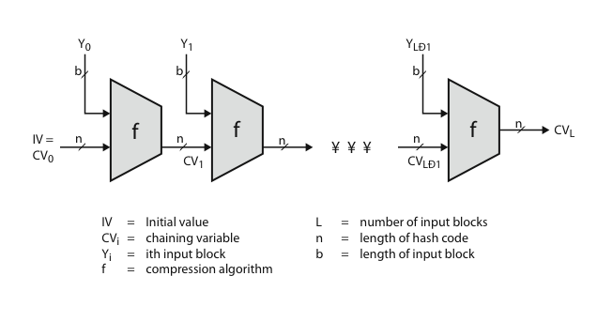
Hash Algorithm Structure
Merkle Damgard Structure
CEG 260, Meilin Liu
Notes:
Zili Shao
Most important modern hash functions follow the basic structure shown in this figure, Stallings Figure 11.9. This has proved to be a fundamentally sound structure, and newer designs simply refine the structure and add to the hash code length. Within this basic structure, two approaches have been followed in the design of the compression function, as mentioned previously, which is the basic building block of the hash function.

Slide 21
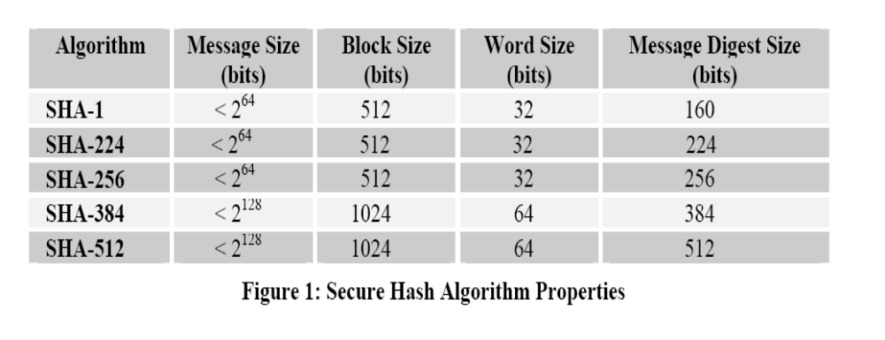
Secure Hash Algorithms
CEG 260, Meilin Liu
Notes:
Zili Shao

Slide 22
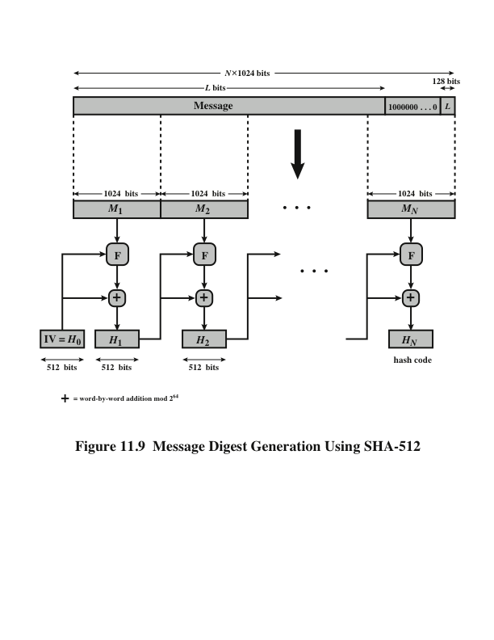
SHA-512 Overview
CEG 260, Meilin Liu
Notes:
Zili Shao
Now examine the structure of SHA-512, noting that the other versions are quite similar.
SHA-512 follows the structure depicted in Stallings Figure 12.1. The processing consists of the following steps:
• Step 1: Append padding bits
• Step 2: Append length
• Step 3: Initialize hash buffer
• Step 4: Process the message in 1024-bit (128-word) blocks, which forms the heart of the algorithm
• Step 5: Output the final state value as the resulting hash
See text for details.

Slide 23
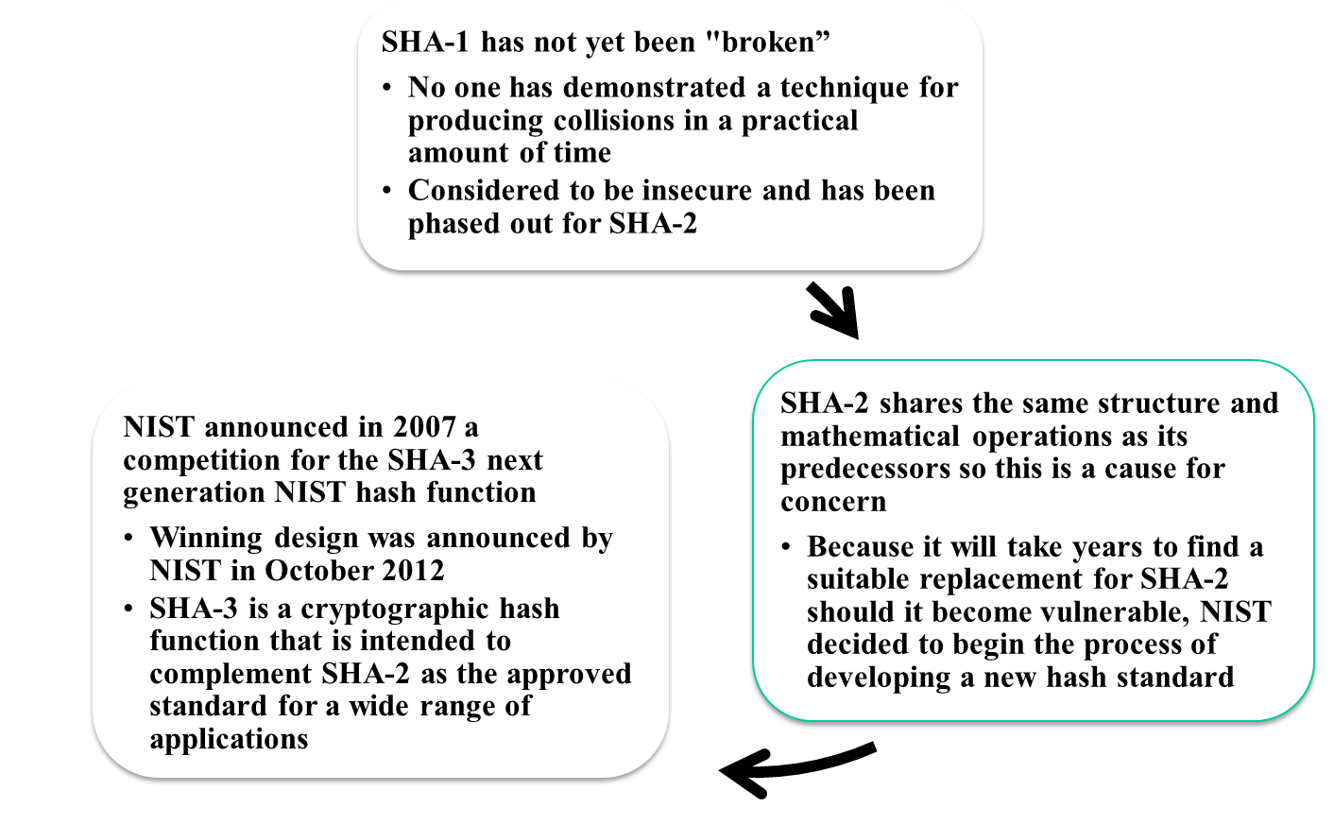
SHA-3
Notes:
As of this writing, the Secure Hash Algorithm (SHA-1) has not yet been “broken.”
That is, no one has demonstrated a technique for producing collisions in a practical
amount of time. However, because SHA-1 is very similar, in structure and in the
basic mathematical operations used, to MD5 and SHA-0, both of which have been
broken, SHA-1 is considered insecure and has been phased out for SHA-2.
SHA-2, particularly the 512-bit version, would appear to provide unassailable
security. However, SHA-2 shares the same structure and mathematical operations
as its predecessors, and this is a cause for concern. Because it will take years to find
a suitable replacement for SHA-2, should it become vulnerable, NIST decided to
begin the process of developing a new hash standard.
Accordingly, NIST announced in 2007 a competition to produce the next generation
NIST hash function, to be called SHA-3. The winning design for SHA-3
was announced by NIST in October 2012. SHA-3 is a cryptographic hash function
that is intended to complement SHA-2 as the approved standard for a wide range
of applications.
Appendix V looks at the evaluation criteria used by NIST to select from
among the candidates for AES, plus the rationale for picking Keccak, which was
the winning candidate. This material is useful in understanding not just the SHA-3
design but also the criteria by which to judge any cryptographic hash algorithm.

Slide 24
The Sponge Construction
Underlying structure of SHA-3 is a scheme referred to by its designers as a sponge construction
Sponge construction: absorbing face, squeezing phase
Takes an input message and partitions it into fixed-size blocks
Each block is processed in turn with the output of each iteration fed into the next iteration, finally producing an output block
The sponge function is defined by three parameters:
  f = the internal function used to process each input block
  r = the size in bits of the input blocks, called the bitrate
  pad = the padding algorithm
Notes:
The underlying structure of SHA-3 is a scheme referred to by its designers as a
sponge construction [BERT07, BERT11]. The sponge construction has the same
general structure as other iterated hash functions (Figure 11.8). The sponge function
takes an input message and partitions it into fixed-size blocks. Each block is
processed in turn with the output of each iteration fed into the next iteration, finally
producing an output block.
The sponge function is defined by three parameters:
f = the internal function used to process each input block
r = the size in bits of the input blocks, called the bitrate
pad = the padding algorithm

Slide 25
Kaccak Function
Sponge function using the permutation Keccak-f
  State b =25*2^l, l= 0, 1, …… , 6
  7 permutations: b∈{25,50,100,200,400,800,1600} …
  # of rounds = 12 + 2*l = 12 + 2*6 = 24
SHA-3 instance: r = 1088 and c = 512
  permutation width: 1600
  security strength 256: post-quantum suﬃcient
Notes:
The underlying structure of SHA-3 is a scheme referred to by its designers as a
sponge construction [BERT07, BERT11]. The sponge construction has the same
general structure as other iterated hash functions (Figure 11.8). The sponge function
takes an input message and partitions it into fixed-size blocks. Each block is
processed in turn with the output of each iteration fed into the next iteration, finally
producing an output block.
The sponge function is defined by three parameters:
f = the internal function used to process each input block
r = the size in bits of the input blocks, called the bitrate
pad = the padding algorithm

Slide 26
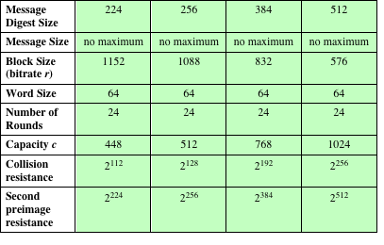
Table 11.5
SHA-3 Parameters
Notes:
Table 11.5 shows the supported values of r and c . As Table 11.5 shows, the hash function security associated
with the sponge construction is a function of the capacity c .

Slide 27
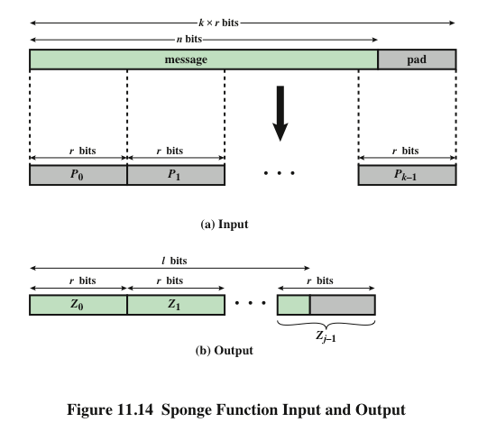
Simple padding is denoted by 10*
Simple padding appends a single bit 1 followed by the minimum number of 0s
such that the length of the result is a multiple of the block length.
Multi-rate padding is denoted by 10*1
Multi-rate padding appends a single bit 1 followed by the minimum number of 0s followed by a single bit 1 such that the length of the result is a multiple of the block length. – FIPS 202
Notes:
A sponge function allows both variable length input and output, making it a
flexible structure that can be used for a hash function (fixed-length output), a pseudorandom
number generator (fixed-length input), and other cryptographic functions.
Figure 11.14 illustrates this point.
The sponge specification proposes [BERT11] proposes
two padding schemes:
• Simple padding: Denoted by pad10*, appends a single bit 1 followed by the
minimum number of bits 0 such that the length of the result is a multiple of the
block length.
• Multirate padding: Denoted by pad10*1, appends a single bit 1 followed by
the minimum number of bits 0 followed by a single bit 1 such that the length of
the result is a multiple of the block length. This is the simplest padding scheme
that allows secure use of the same f with different rates r .

Slide 28
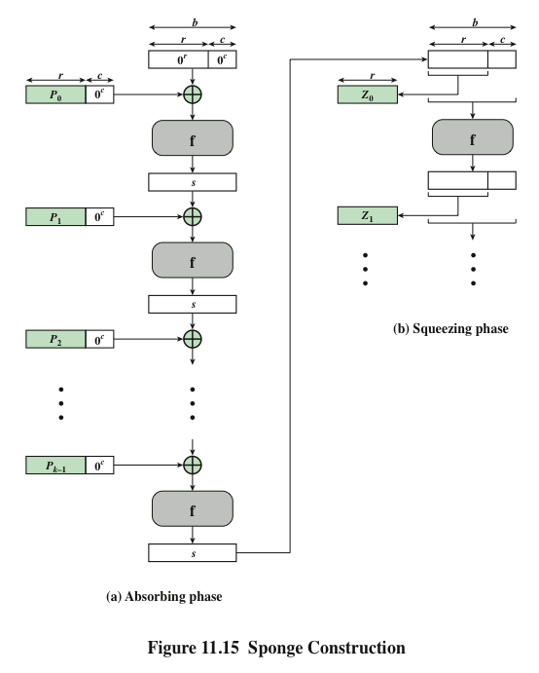
Notes:
Figure 11.15 shows the iterated structure of the sponge function. The sponge
construction operates on a state variable s of b = r + c bits, which is initialized to all
zeros and modified at each iteration. The value r is called the bitrate. This value is
the block size used to partition the input message. The term bitrate reflects the fact
that r is the number of bits processed at each iteration: the larger the value of r , the
greater the rate at which message bits are processed by the sponge construction.
The value c is referred to as the capacity . A discussion of the security implications of
the capacity is beyond our scope. In essence, the capacity is a measure of the achievable
complexity of the sponge construction and therefore the achievable level of
security. A given implementation can trade claimed security for speed by increasing
the capacity c and decreasing the bitrate r accordingly, or vice versa. The default
values for Keccak are c = 1024 bits, r = 576 bits, and therefore b = 1600 bits.

Slide 29
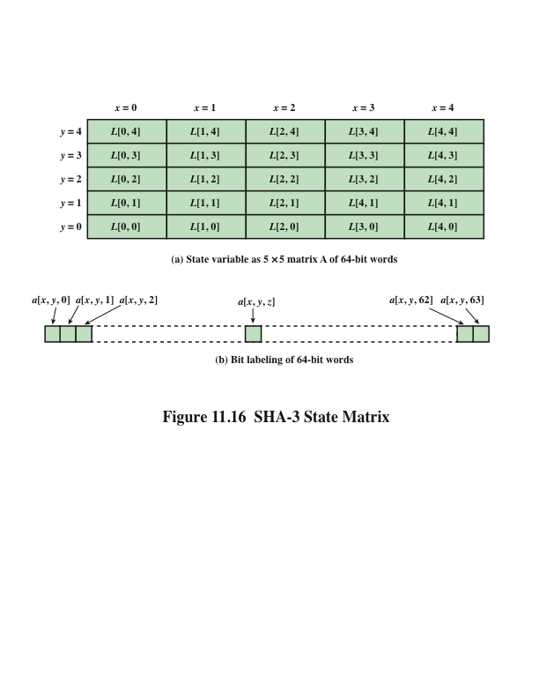
The Iteration Function f of SHA-3
Notes:
We now examine the iteration function Keccak-f used to process each successive
block of the input message. Recall that f takes as input a 1600-bit variable s consisting
of r bits, corresponding to the message block size followed by c bits, referred to as the
capacity. For internal processing within f , the input state variable s is organized as a
5 * 5 * 64 array a . The 64-bit units are referred to as lanes . For our purposes, we generally
use the notation a [x , y , z ] to refer to an individual bit with the state array. When
we are more concerned with operations that affect entire lanes, we designate the
5 * 5 matrix as L [x , y ], where each entry in L is a 64-bit lane. The use of indices
within this matrix is shown in Figure 11.16. Thus, the columns are labeled x = 0
through x = 4, the rows are labeled y = 0 through y = 4, and the individual bits
within a lane are labeled z = 0 through z = 63.
The mapping between the bits of s
and those of a is
s [64(5y + x ) + z ] = a [x , y , z ]
We can visualize this with respect to the matrix in Figure 11.16. When treating
the state as a matrix of lanes, the first lane in the lower left corner, L [0, 0], corresponds
to the first 64 bits of s . The lane in the second column, lowest row, L [1, 0],
corresponds to the next 64 bits of s . Thus, the array a is filled with the bits of s starting
with row y = 0 and proceeding row by row.

Slide 30
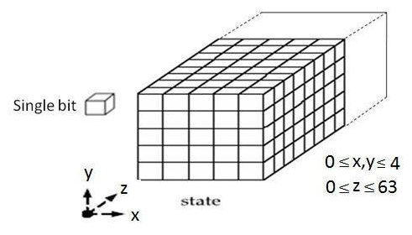
The Iteration Function f of SHA-3
The state: an array of 5 * 5 * 2^ℓ bits (l=6) = 5 * 5 * 64 =1600
The b= 1600 bit state can be viewed as a 3-dimensional array
5×5 lanes (words), each containing 64 bits
Notes:
We now examine the iteration function Keccak-f used to process each successive
block of the input message. Recall that f takes as input a 1600-bit variable s consisting
of r bits, corresponding to the message block size followed by c bits, referred to as the
capacity. For internal processing within f , the input state variable s is organized as a
5 * 5 * 64 array a . The 64-bit units are referred to as lanes . For our purposes, we generally
use the notation a [x , y , z ] to refer to an individual bit with the state array. When
we are more concerned with operations that affect entire lanes, we designate the
5 * 5 matrix as L [x , y ], where each entry in L is a 64-bit lane. The use of indices
within this matrix is shown in Figure 11.16. Thus, the columns are labeled x = 0
through x = 4, the rows are labeled y = 0 through y = 4, and the individual bits
within a lane are labeled z = 0 through z = 63.
The mapping between the bits of s
and those of a is
s [64(5y + x ) + z ] = a [x , y , z ]
We can visualize this with respect to the matrix in Figure 11.16. When treating
the state as a matrix of lanes, the first lane in the lower left corner, L [0, 0], corresponds
to the first 64 bits of s . The lane in the second column, lowest row, L [1, 0],
corresponds to the next 64 bits of s . Thus, the array a is filled with the bits of s starting
with row y = 0 and proceeding row by row.

Slide 31
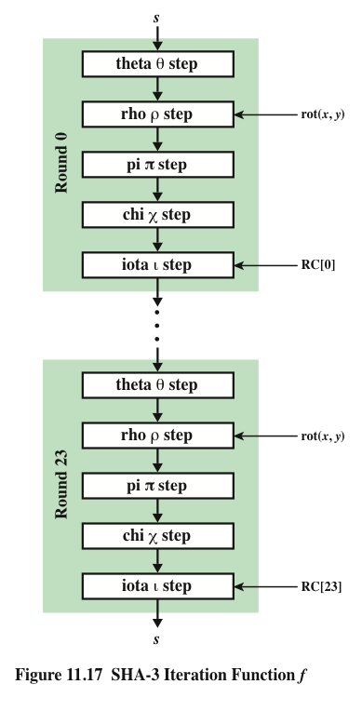
SHA-3
Iteration Function f
Notes:
The function f is executed once for each input block of the message
to be hashed. The function takes as input the 1600-bit state variable and converts
it into a 5 * 5 matrix of 64-bit lanes. This matrix then passes through 24 rounds of
processing. Each round consists of five steps, and each step updates the state matrix
by permutation or substitution operations. As shown in Figure 11.17, the rounds are
identical with the exception of the final step in each round, which is modified by a
round constant that differs for each round.

Slide 32
HMAC
specified as Internet standard RFC2104
uses hash function on the message:
  HMAC_{K} = Hash[(K⁺ XOR opad) ||
  Hash[(K⁺ XOR ipad)||M)]]
where K⁺ is the key padded out to block size (b bits)
opad, ipad are specified padding constants
  ipad:00110110(36 in hexidecimal) repeated by b/8 times
  opad:01011100(5C in hexidecimal) repeated by b/8 times
overhead is just 3 more hash calculations than the message needs alone
any hash function can be used
  eg. MD5, SHA-1, RIPEMD-160, Whirlpool
CEG 260, Meilin Liu
Notes:
Zili Shao
The idea of a keyed hash evolved into HMAC, designed to overcome some problems with the original proposals. It involves hashing padded versions of the key concatenated with the message, and then with another outer hash of the result prepended by another padded variant of the key. The hash function need only be used on 3 more blocks than when hashing just the original message (for the two keys + inner hash). HMAC can use any desired hash function, and has been shown to have the same security as the underlying hash function. Can choose the hash function to use based on speed/security concerns.

Slide 33
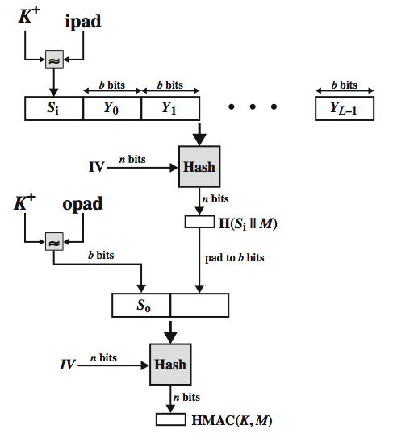
HMAC Overview
CEG 260, Meilin Liu
Notes:
Zili Shao
Stallings Figure 12.10 shows the structure of HMAC, which implements the function:
HMAC_{K} = Hash[(K⁺ XOR opad) || Hash[(K⁺ XOR ipad) || M)]
elements are:
K⁺ is K padded with zeros on the left so that the result is b bits in length
ipad is a pad value of 36 hex repeated to fill block
opad is a pad value of 5C hex repeated to fill block
M is the message input to HMAC (including the padding specified in the embedded hash function)

Slide 34
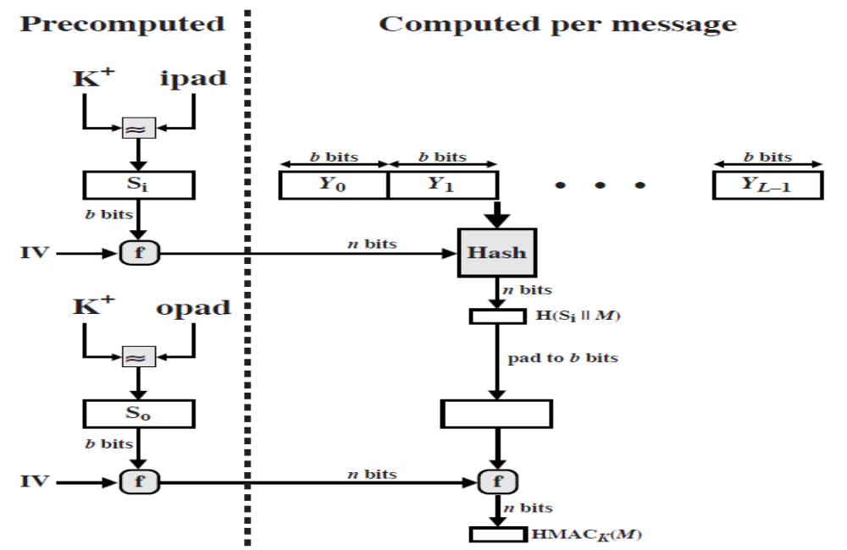
Efficient Implementation of HMAC
CEG 260, Meilin Liu
Notes:
Zili Shao
Stallings Figure 12.10 shows the structure of HMAC, which implements the function:
HMAC_{K} = Hash[(K⁺ XOR opad) || Hash[(K⁺ XOR ipad) || M)]
elements are:
K⁺ is K padded with zeros on the left so that the result is b bits in length
ipad is a pad value of 36 hex repeated to fill block
opad is a pad value of 5C hex repeated to fill block
M is the message input to HMAC (including the padding specified in the embedded hash function)

Slide 35
CMAC
previously saw the DAA (CBC-MAC)
widely used in govt & industry
but has message size limitation
can overcome using 2 keys & padding
thus forming the Cipher-based Message Authentication Code (CMAC)
adopted by NIST SP800-38B
Notes:
The Data Authentication Algorithm cipher-based MAC has been widely adopted in government and industry. Has been shown to be secure, with the following restriction. Only messages of one fixed length of mn bits are processed, where n is the cipher block size and m is a fixed positive integer. This limitation can be overcome using multiple keys, which can be derived from a single key. This refinement has been adopted by NIST as the cipher-based message authentication code (CMAC) mode of operation, for use with AES and triple DES. It is specified in NIST Special Publication 800-38B.

Slide 36
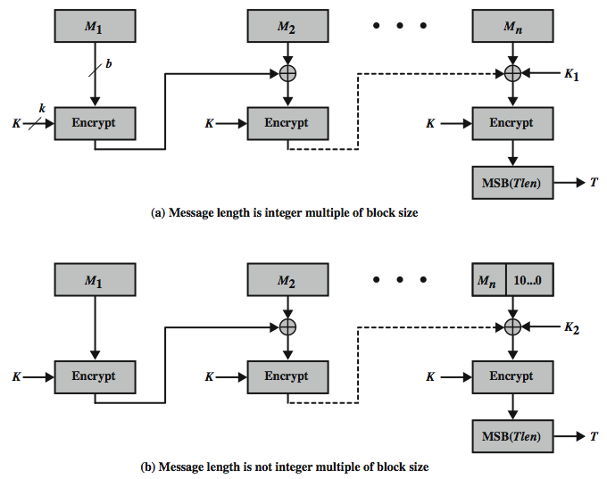
CMAC Overview
Notes:
Stallings Figure 12.8 shows the structure of CMAC. It uses the blocksize of the underlying cipher (ie 128-bits for AES or 64-bits for triple-DES). The message is divided into n blocks M1..Mn, padded if necessary. The algorithm makes use of a k-bit encryption key K and an n-bit constant K1 or K2 (depending on whether the message was padded or not). For AES, the key size k is 128,192, or 256 bits; for triple DES, the key size is 112 or 168 bits. The two constants K1 & K2 are derived from the original key K using encryption of 0 and multiplication in GF(2^n), as detailed in the text.

Slide 37
CMAC
K1, K2 derivation:
L = E(K, 0^b)
K1 = L * x
K2 = L * x^2 = (L*x)* x
The prime polynomials are x^64 +x^4 + x^3 + x +1 or x^128 +x^7 + x^2 + x +1
Notes:
The Data Authentication Algorithm cipher-based MAC has been widely adopted in government and industry. Has been shown to be secure, with the following restriction. Only messages of one fixed length of mn bits are processed, where n is the cipher block size and m is a fixed positive integer. This limitation can be overcome using multiple keys, which can be derived from a single key. This refinement has been adopted by NIST as the cipher-based message authentication code (CMAC) mode of operation, for use with AES and triple DES. It is specified in NIST Special Publication 800-38B.

Slide 38
Summary
have considered:
  HMAC authentication using hash function
  CMAC authentication using a block cipher
CEG 260, Meilin Liu
Notes:
Zili Shao
Chapter 12 summary.

Slide 39
Key Management Problem
Key Generation
Key Distribution
  Distributing your own public key
  Obtaining someone else’s public key
    Certificate Authority…
Key storage
  Secure storage of keys
Revocation
  Revoke the key if it is compromised
  Determining whether a published key is still valid
CEG 260, Meilin Liu
Notes:
Zili Shao

Slide 40
Distribution of Public Keys
Distribution method of Public Keys
  Public Announcements
  Publicly available Directory
  Public-key Authority
  Public-key Certificates
CEG 260, Meilin Liu
Notes:
Zili Shao

Slide 41
Public-Key Certificates
Certificates allow key exchange without real-time access to public-key authority
A certificate binds identity to public key
  usually with other info such as period of validity, rights of use etc
With all contents signed by a trusted Public-Key or Certificate Authority (CA)
Can be verified by anyone who knows the public-key authorities public-key
CEG 260, Meilin Liu
Notes:
Zili Shao
An further improvement is to use certificates, which can be used to exchange keys without contacting a public-key authority, in a way that is as reliable as if the keys were obtained directly from a public-key authority. A certificate binds an identity to public key, with all contents signed by a trusted Public-Key or Certificate Authority (CA). This can be verified by anyone who knows the public-key authorities public-key.
One scheme has become universally accepted for formatting public-key certificates: the X.509 standard. X.509 certificates are used in most network security applications, including IP security, secure sockets layer (SSL), secure electronic transactions (SET), and S/MIME. Will discuss it in much more detail later.

Slide 42
Certificates
Certificates containing
  Identity of principal (here, Alice)
  Corresponding public key
  Timestamp (when issued)
  Other information (perhaps identity of signer)
signed by trusted authority (here, Cathy)
C_{A} = E(PRauth, {T || IDa ||PUa})
  Cathy<<Alice>>
CEG 260, Meilin Liu
Notes:
Zili Shao

Slide 43
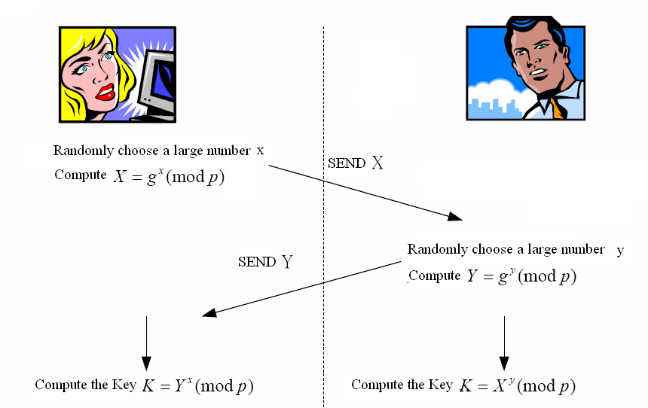
Diffie-Hellman Key Distribution System
CEG 260, Meilin Liu
Notes:
Zili Shao
The prime q and primitive root α can be common to all using some instance of the D-H scheme. Note that the primitive root α is a number whose powers successively generate all the elements mod q. Alice and Bob choose random secrets x's, and then "protect" them using exponentiation to create the y's. For an attacker monitoring the exchange of the y's to recover either of the x's, they'd need to solve the discrete logarithm problem, which is hard.

Slide 44
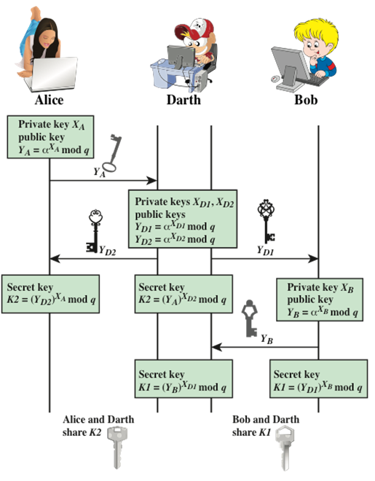
Man-in-the-Middle Attack

Slide 45
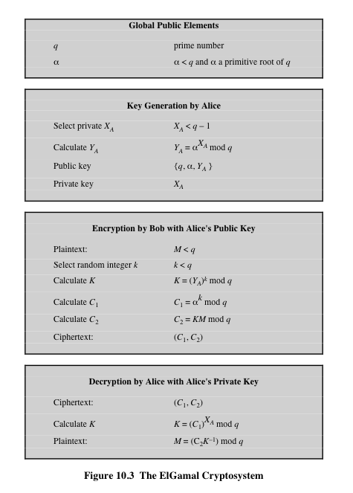
The ElGamal system
© 2017 Pearson Education, Inc., Hoboken, NJ. All rights reserved.
Notes:
Figure 10.3 summarizes the ElGamal Cryptosystem. It corresponds to Figure 9.1a.
Alice generates a public/private key pair; Bob encrypts using Alice’s public key; and
Alice decrypts using her private key.

Slide 46
The ElGamal system (a modern view)
Fix a finite cyclic group G (e.g G = Zp* )
Fix a generator g in G (i.e. G = {1, g, g², g³, … , g^{p-2}} )
(E_{s}, D_{s}) : symmetric auth. encryption defined over (K,M,C)
H: G² ⟶ K: a hash function
We construct a pub-key enc. system (Gen, E, D):
Key generation Gen: (pk, sk)
  choose random generator g in Zp* and random a in Zp*
  output sk = a, pk = (g, h= g^a mod p)
Notes:
Call pub-key “h” instead of “A”

Slide 47
The ElGamal system (a modern view)
Fix a finite cyclic group G (e.g G = Zp* )
Fix a generator g in G (i.e. G = {1, g, g², g³, … , g^{p-2}} )
(E_{s}, D_{s}) : symmetric auth. encryption defined over (K,M,C)
H: G² ⟶ K a hash function
Bob:
E( pk=(g, h), m) :
b ⟵ Zp* , u ⟵ g^b mod p, v ⟵ h^b mod p
k ⟵ H(u,v) , c ⟵ E_{s}(k, m)
output (u, c)
R
Alice:
D( sk=a, (u,c) ) :
v ⟵ uª
k ⟵ H(u,v) , m ⟵ D_{s}(k, c)
output m

Slide 48
Access Control
Two parts to access control
Authentication: Are you who you say you are?
  Determine whether access is allowed
  Authenticate human to machine
  Or authenticate machine to machine
Authorization: Are you allowed to do that?
  Once you have access, what can you do?
  Enforces limits on actions
Note: “access control” often used as synonym for authorization
CS7900, Meilin Liu

Slide 49
Authentication: Are You Who You Say You Are?
How to authenticate human a machine?
Can be based on…
  Something you know
    For example, a password
  Something you have
    For example, a smartcard
  Something you are
    For example, your fingerprint
CS7900, Meilin Liu

Slide 50
2-factor Authentication
Requires any 2 out of 3 of
  Something you know
  Something you have
  Something you are
Examples
  ATM: Card and PIN
  Credit card: Card and signature
  Password generator: Device and PIN
  Smartcard with password/PIN
CS7900, Meilin Liu

